Slide 1
DESIGNING A UNIFIED THREAT MANAGEMENT SYSTEM FOR HOME NETWORKS
Guided by
Dr. M. Blessy Queen Mary M.E, PH.D.
Team Members
Aswin S - 71772218102
Janardhan M - 71772218116
Praghadeesh S - 71772218138
Iyappan K - 71772218L04

Slide 2
PROBLEM IDENTIFICATION
Existing System:
  Home Routers focus on Connectivity and not Security.
  Systems use basic firewalls/antivirus, limited to Layer 3/4 filtering.
  Corporate UTM Solutions need high resources.
  UTMs depend on paid signature updates, lack of dynamic IoC feeds.
Issues in the System
  The Home Network is the New Perimeter.
  Explosive Growth with inadequate Defense.
  A dangerous vacuum in security, with users lacking technical expertise.
  Security tools are isolated and not integrated.

Slide 3
PROPOSED SYSTEM
Smart Unified Threat Management System (SUTMS) on an Edge Device ( RaspberryPi ).
OBJECTIVES
  Provide corporate-grade security to personal/home devices like laptops, mobiles, and IoT gadgets.
  Ensure multi-layered protection – Flow detection, Intrusion detection, Firewall, Anti-bot protection.
  Develop a lightweight, cost-effective, and easy-to-deploy solution using Raspberry Pi.
  Reduce CPU/memory usage while maintaining high detection accuracy (≈99%).

Slide 4
LITERATURE SURVEY
Paper | Problem/Objective | Method/Module | Key Considerations | Limitations
Intrusion Detection for IoT-enabled Smart Homes | Smart homes face frequent cyber threats due to weak device security. | ML-based intrusion detection focusing on anomaly detection. | Must be lightweight, accurate, and adaptive. | Simulation-based, dataset-dependent, may not generalize to real IoT attacks.
Phishing/Malicious URL Detection with Raspberry Pi | Home networks often fail to detect phishing URLs; need cost-effective solution. | NETBITS on Raspberry Pi using URL feature analysis & classification. | Low-cost hardware, real-time monitoring, feasible for small networks. | Focuses only on URL-based threats; Raspberry Pi has limited processing power.
Traffic Trace Artifacts from Port Mirroring | Port mirroring (SPAN) used for monitoring may distort traffic traces. | Studied artifacts like packet loss & timing distortion in switches/routers. | IDS accuracy depends on fidelity of captured traces. | Only studies port mirroring, not other capture methods; based on older hardware.
Performance of Open-source IDS in High-speed Networks | IDS like Snort, Suricata, Bro face bottlenecks in Gbps traffic environments. | Benchmarked IDS performance (throughput, packet loss, detection accuracy). | Requires multi-threading, optimized rules, hardware acceleration. | Hardware-dependent results; focus on performance, not detection improvements.

Slide 5
LITERATURE SURVEY
Paper | Problem/Objective | Method/Module | Key Considerations | Limitations
Survey on Unified Threat Management (UTM) Systems for Home Networks | Home/SoHo networks need enterprise-level security, but UTMs are built mainly for enterprises. | Surveyed UTM approaches (firewall, IDS/IPS, antivirus, anti-bot) and deployment issues. | Constraints on cost, usability, and integration with threat intelligence (STIX/TAXII). | Purely survey-based, no prototype or deployment solution.
Comprehensive Study on STIX and TAXII | Threat intelligence sharing lacks standardization. | Analyzed STIX (Structured Threat Information Expression) and TAXII (Trusted Automated Exchange of Indicator Information). | Machine-readable intel sharing, interoperability, importance for adaptive firewalls/IDS. | Machine-readable intel sharing, interoperability, importance for adaptive firewalls/IDS.
IoT Device Classification using Machine Learning | Classify IoT devices to detect anomalies or threats. | ML-based classification models with feature extraction from device behavior. | Accurate classification prevents misuse; requires good training and preprocessing. | Relies on labeled datasets; models may drift with new devices or attack types.
Automatic Device Classification using Arduino Platform | Identify/classify IoT devices for stronger network security. | Device identification algorithms using Arduino hardware. Real-time classification based on communication patterns. | Efficient resource use, adaptability across device types. | Limited processing capacity, risk of misclassification in noisy networks.

Slide 6
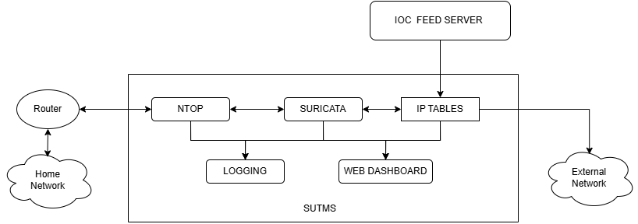
SYSTEM ARCHITECTURE
DEPLOYMENT STRATEGY :
Inline with Existing Router — Lives between internal network and external network

Slide 7
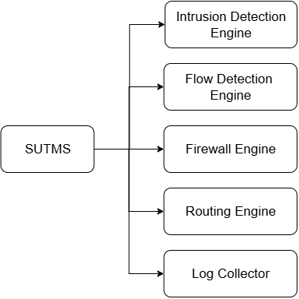
SUTMS – CORE MODULES
Flow Detection Engine ( NTOP )
  Identify Traffic Patterns.
  Detects anomalies.
Intrusion Detection Engine ( Suricata )
  Matches traffic to known attack patterns.
  Can operate in IDS or IPS mode.
  Aho-Corasick Pattern Matching Algorithm.
Firewall ( Iptables + IoC feeds via STIX/TAXII )
  Blocks malicious IPs dynamically.
  Enhances anti-bot protection.

Slide 8
INNOVATION & TECHNOLOGIES
Integration of NTOP and Suricata:
  NTOPng collects flow data from all connected devices.
  Flow details are shared with Suricata for focused packet inspection.
  Suricata analyzes only selected protocols and skips rest.
  Together, they provide accurate, fast, and real-time network protection.
Custom IoC Feed Server
  Aggregates IoCs from multiple open threat servers (STIX/TAXII, OTX, Anomali, etc.).
  Supplies optimized IoC lists to the firewall for real-time dynamic blocking.
  Maintains local caching → works even when external feeds are offline.
  Can validate and verify IoC Signatures before deployment.

Slide 9
UNIFIED MONITORING
Web Dashboards
Built and configured dashboards for administrative control and monitoring of SUTMS.
Core Functions:
    Update or modify custom firewall rules dynamically.
    Option to by-pass SUTMS blocking (for work-from-home flexibility).
    Resource Monitoring: Tracks CPU, RAM, and disk usage in real time.
    Network Status Dashboard: Displays traffic flow, bandwidth, and device activity.
    Extends to integrate NTOPng and Suricata web interfaces for deeper analytics.

Slide 10
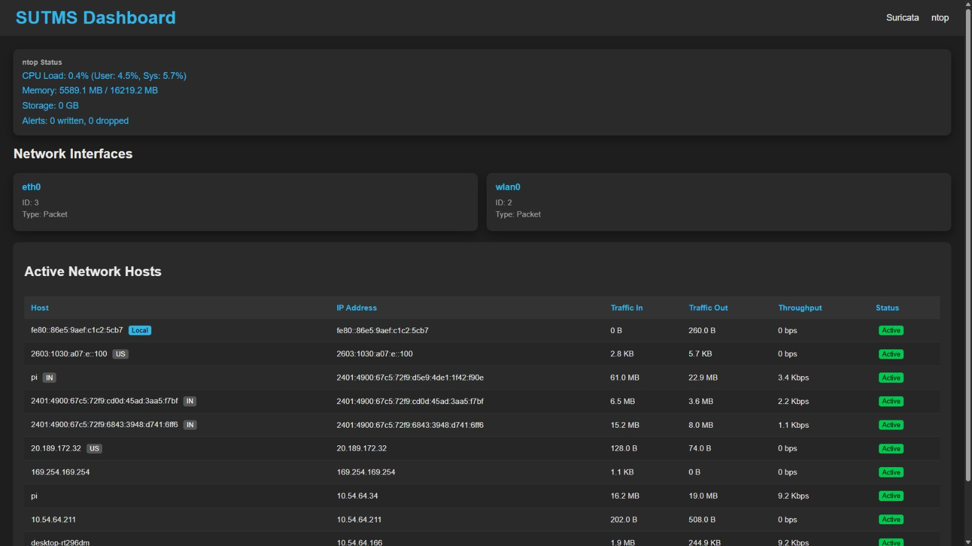
PROJECT OUTCOME

Slide 11
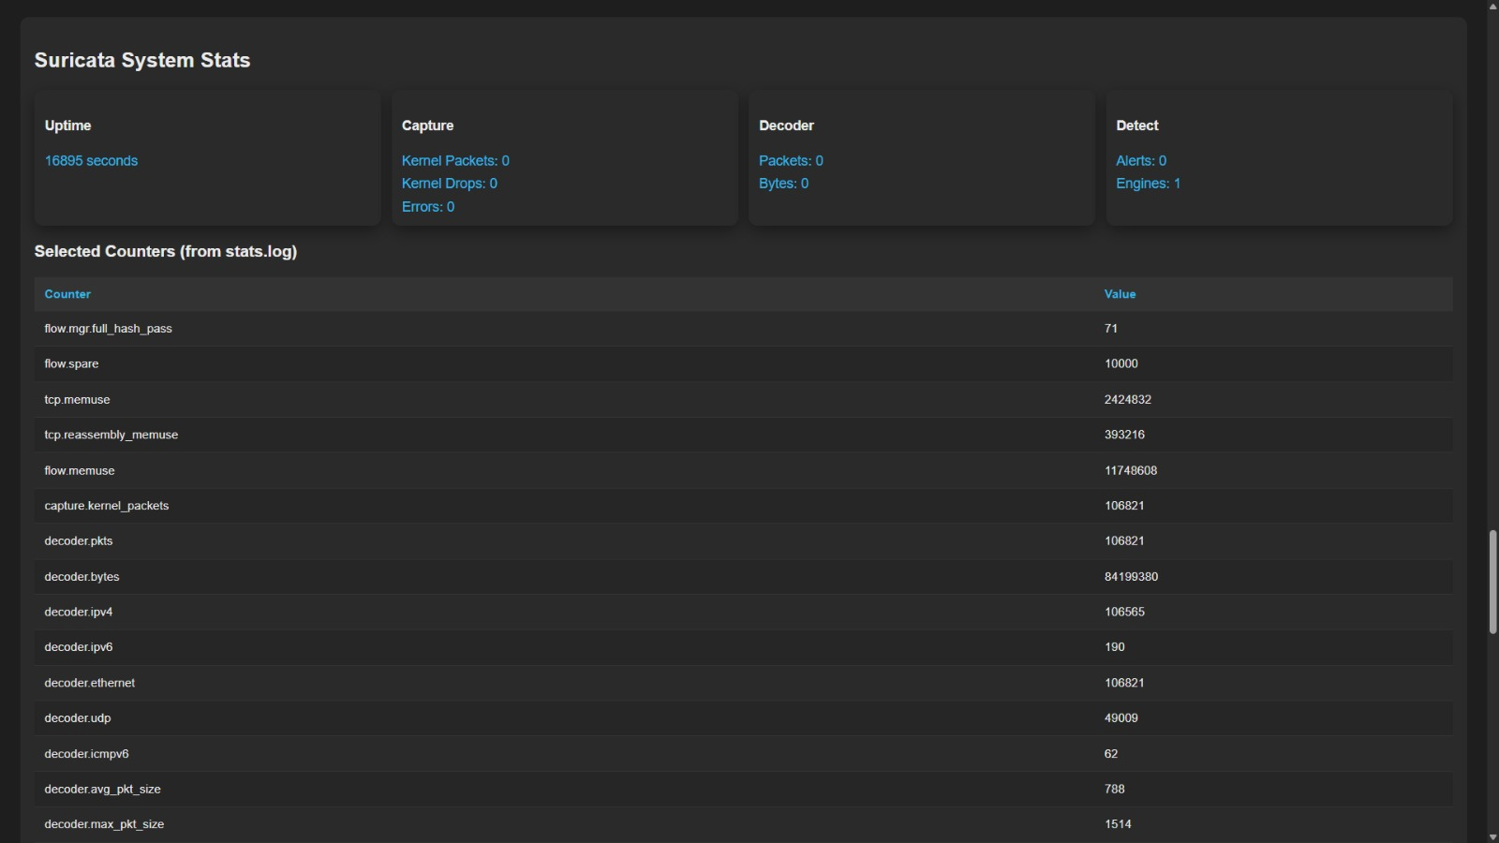
PROJECT OUTCOME

Slide 12
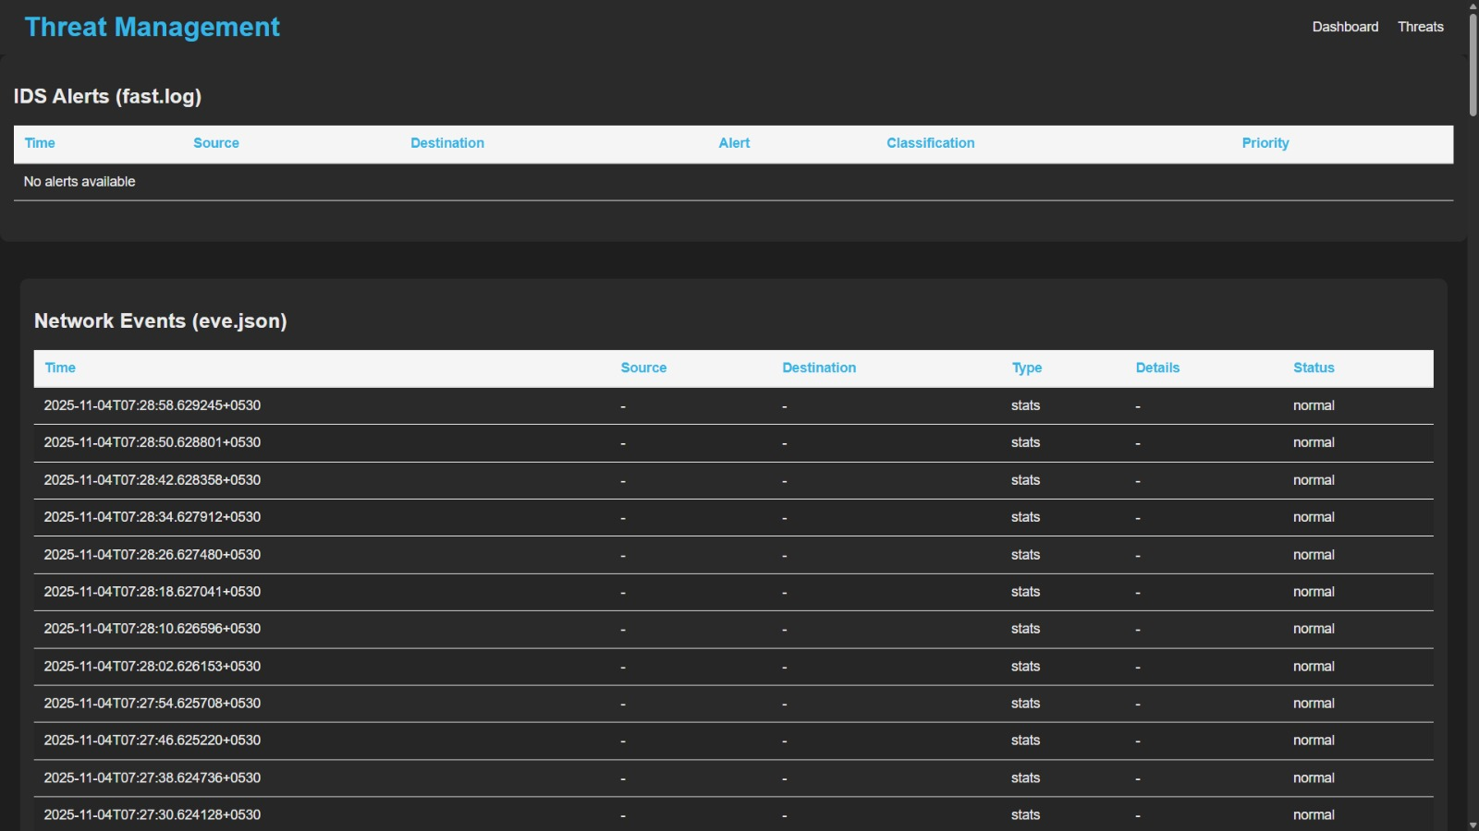
PROJECT OUTCOME

Slide 13
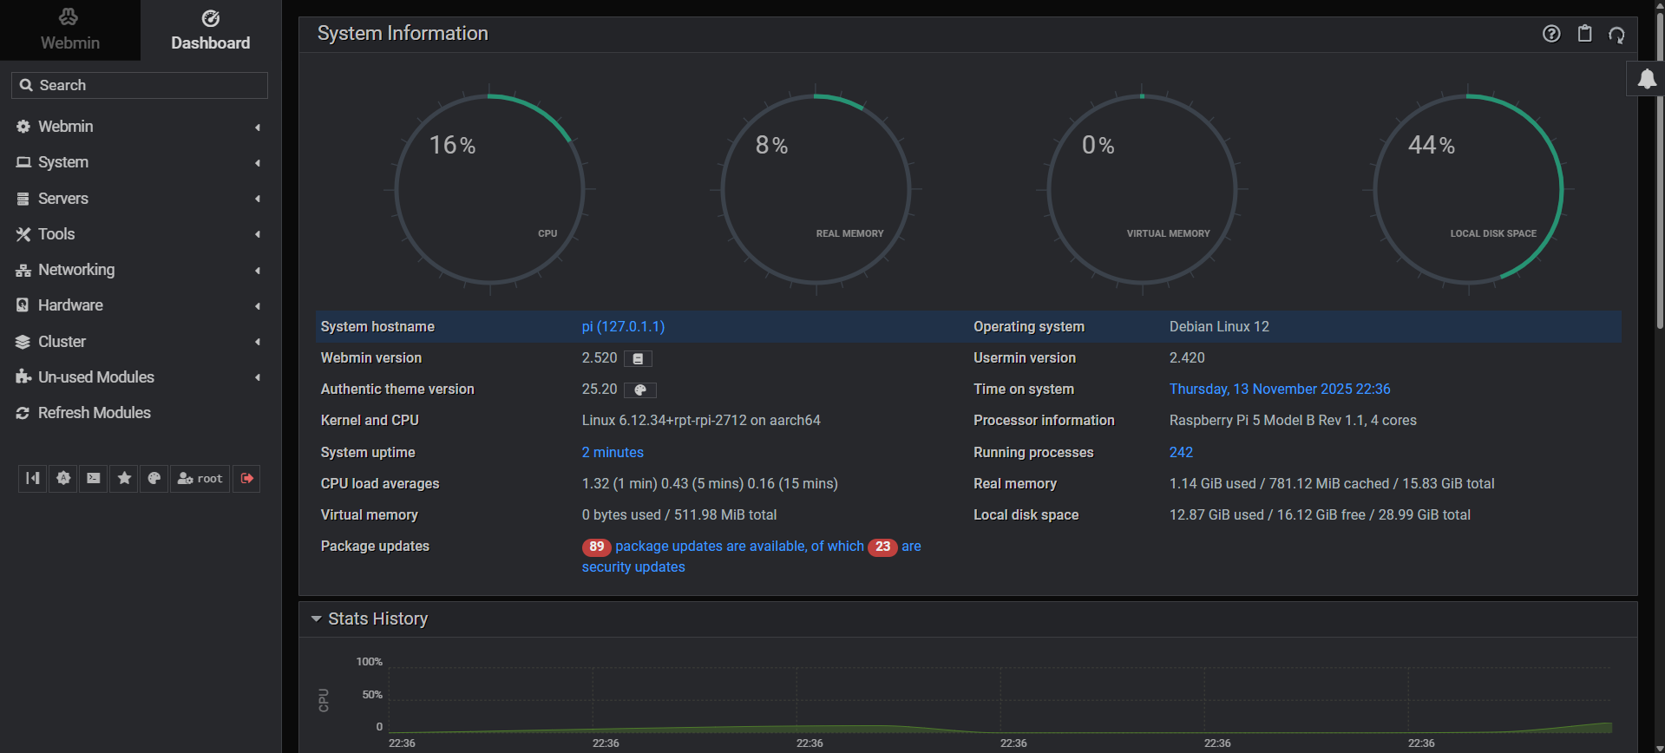
PROJECT OUTCOME

Slide 14
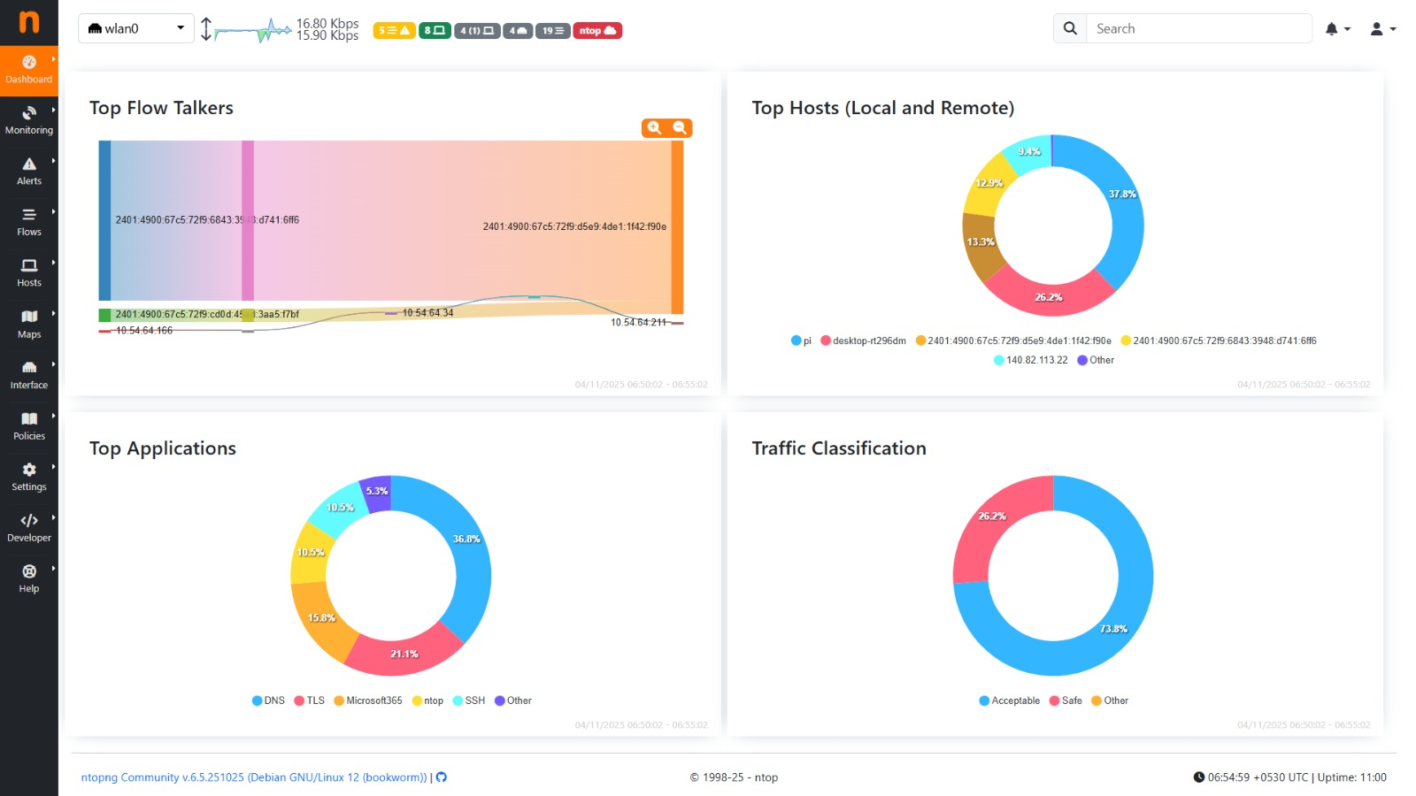
PROJECT OUTCOME

Slide 15

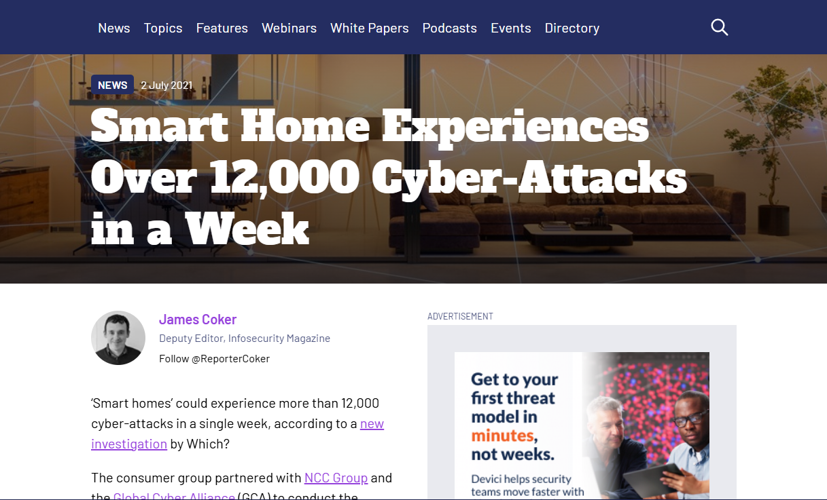
SOCIAL IMPACT & SUSTAINABLITY
Current Home Networks Threads :
Outcomes :
  Protects employees working remotely with secure home network connections.
  Builds corporate confidence in remote and hybrid work environments.
  Non-technical users protect their home network easily..

Slide 16
FUTURE ENHANCEMENTS
1. SSL/TLS Inspection:
Improve handling of encrypted traffic by enabling secure and efficient packet decryption for malware hidden within SSL/TLS layers.
2. Threat Feed Validation:
Develop verified and AI/blockchain-powered systems to validate Indicators of Compromise (IoCs) from multiple sources, ensuring accuracy and reducing false positives.
3. IDS Optimization:
Create smarter, open-source detection engines with data-mining algorithms (like Apriori) to reduce false alerts, adapt to new applications, and defend against zero-day threats.

Slide 17
SUTMS – Commercial Deployment
A home-network security device offering enterprise-level protection for laptops, mobiles, and IoT devices.
Target Customers
  Remote employees working from home
  Small offices / home offices (SOHO)
  Houses with many smart/IoT devices
  Home users who want better security

Slide 18
Q & A

Slide 19
THANK YOU

